Slide 1
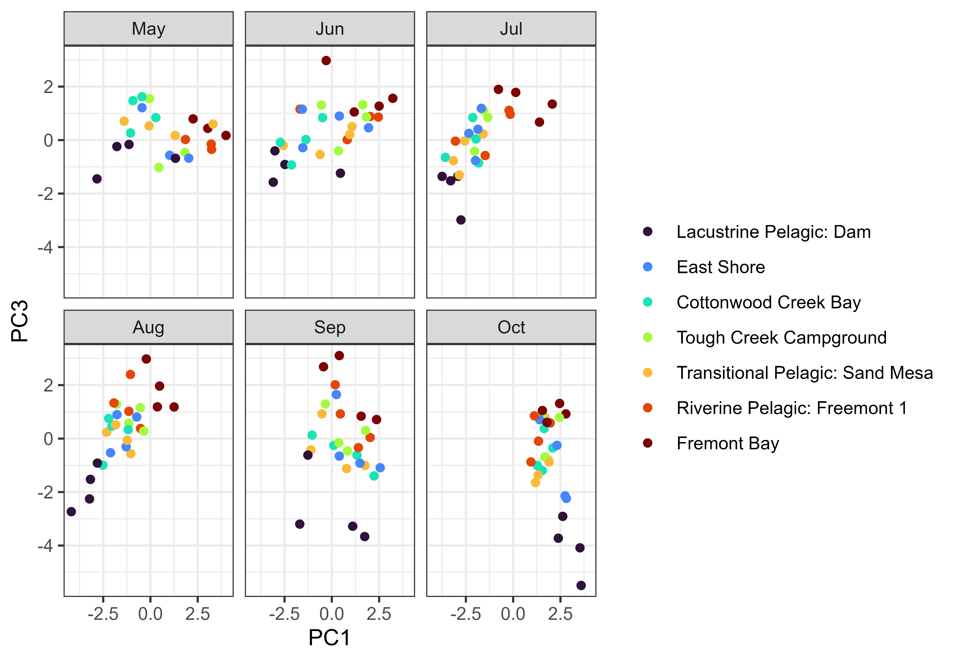
lm(site location ~ PC1 + PC3)
R2 = 0.52
p < 0.0001
+
+
+
Inorganic N
Secchi depth
Maximum depth
-
-
-
-
-
+
+
+
+
Phosphate
TP
TN:TP
Inorganic N:phosphate
Temperature
Schmidt’s Stability
+
+
-
-
-
-

